Slide 1
Latch-up phenomenon and prevention,
from theory to practice
© 2011 Renesas Design Corp. All rights reserved.

Slide 2
Outline
Latch-up introduction
Thyristor Review.
Latch-up trigger modes
Preventing Latch-up
Layout rules relating to latch-up preventing

Slide 3
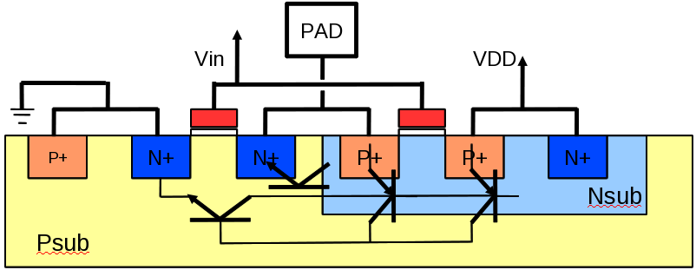
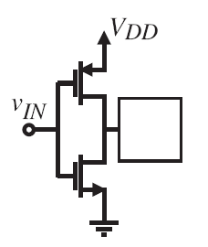
Latch-up introduction
• Latch-up is the creation of a low impedance path between the power supply rails .
VDD
This low impedance path conducts a large current flow from Power (VCC) to ground (VSS), usually resulting in destruction of the chip, or a system failure that can only be resolved by power-down.
Large current
• Latch-up is caused by the triggering of parasitic bipolar structures within an integrated circuit when applying a current or voltage stimulus on an I/O PAD or by an over-voltage on the power supply pin.
Example: there are many parasitic bipolar structures inside an inverter.
PAD

Slide 4
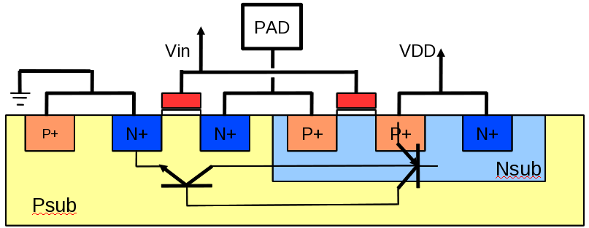
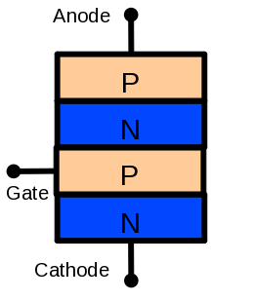
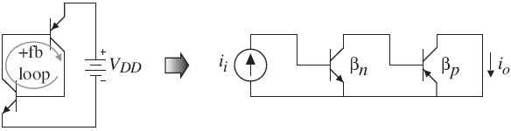

Thyristor review
• The parasitic bipolar structure mention above is a pnpn structure (SCR: Silicon Controlled Rectifier ) formed by a parasitic npn and a parasitic pnp transistor.
SCR can be triggered by two different mechanisms.
1.) Allowing V_{AK} to exceed the sustaining voltage, VS.
2.) Injection of current I_{G} by a triggering device (gate triggered)
I_{AK}
Anode
V_{AK}
I_{G}
I_{G}>>0
I_{G}>0
Gate
I_{G}=0
Cathode
Holding current
V_{AK}
Sustaining
Voltage,Vs

Slide 5
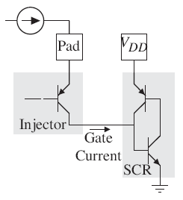
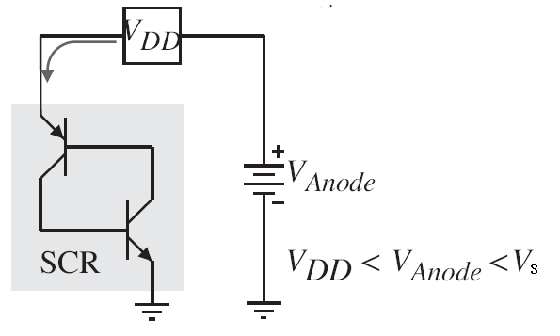
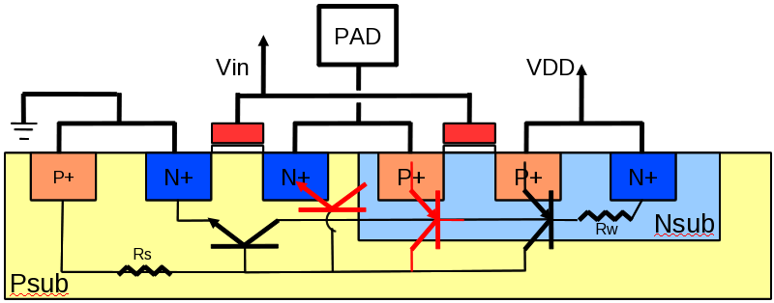
Latch-up trigger mode
1.) Voltage mode
2.) Current mode
When a current is applied to a pad, it can flow through an injector and trigger latchup of an SCR
SCR gate current injection parasitic can occur in pwell or n-well technology.
If Power supply is above nominal value, the SCR can be triggered
From the above considerations, latchup requires the following components:
1.) A four-layer structure (SCR) connected between VDD and ground.
2.) An injector.
3.) A stimulus: injection of current.

Slide 6
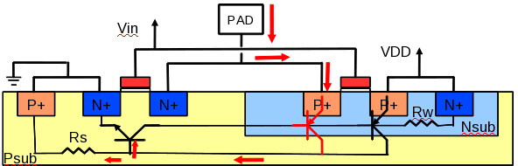
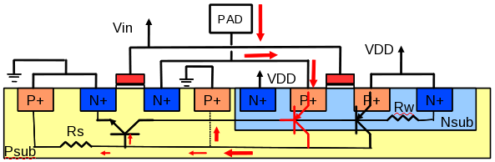
Preventing Latch-up
1.) Keep the source/drain of the MOS device not in the well as far away from the well as
possible. This will lower the value of the BJT betas.
Loop gain:
2.) Reduce the values of Rw and Rs. This requires more current before latch-up can
occur.
3.) Surround the transistors with guard rings. Guard rings reduce transistor betas and
divert collector current from the base of SCR transistors.
Add guardring

Slide 7
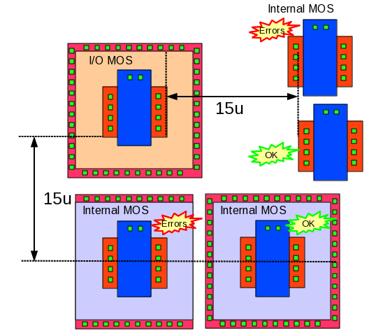
Layout rule relating to Latch-up preventing
LUP.2 is the rule concern to latch-up error between IO MOS and internal MOS
LUP.2 area checking is extended area 15um from OD of IO MOS
1.)Within 15 um space from the MOS connected to an I/O pad, do not place any internal MOS (which is not have full guard-ring – p+ guard-ring or n+ guardring) inside this area
2.)Cover all internal MOS with full guardring (p+ guardring or n+ guardring)
Notes:
I/O MOS is MOSFET connected to external pin.
Internal MOS is MOSFET not connected to external pin.
Rule file: CN45_6M_3X1Z1U.21a_sub_b
Process: TSMC40lp

Slide 8
© 2014 Renesas Design Corp. All rights reserved.

